Slide 1

Exploratory Data Analysis
G2M (cab industry) case study
04-Aug-2021
Bogdan Anghelus

Slide 2
Context – G2M (cab industry investment) case study
XYZ is a private firm in US. Due to remarkable growth in the Cab Industry in last few years and multiple key players in the market, it is planning for an investment in Cab industry and as per their Go-to-Market(G2M) strategy they want to understand the market before taking final decision.
Objective: Based on the provided data, construct an analysis for helping the company decide in what Cab should they invest in.
The analysis was constructed in 3 parts:
Data understanding
Analyzing the travel frequency and the cities with the most traffic for both cabs
Finding the most relevant details with respect to the profit of the two cab companies

Slide 3
Data Exploration
4 individual datasets: Cab_Data.csv, Customer_ID.csv, Transaction_ID.csv, City.csv
Time period of Data: 31/01/2016 to 31/12/2018
No null values
Assumptions to be tested:
There are certain months/month that raise the travel frequency for both cabs.
The crowded cities should be the “heart” of USA: NY, LA, Chicago, Washington.
From the profit point of view, the company with the main customer frequency should have the highest profit per ride and the highest profit overall (monthly & yearly).

Slide 4
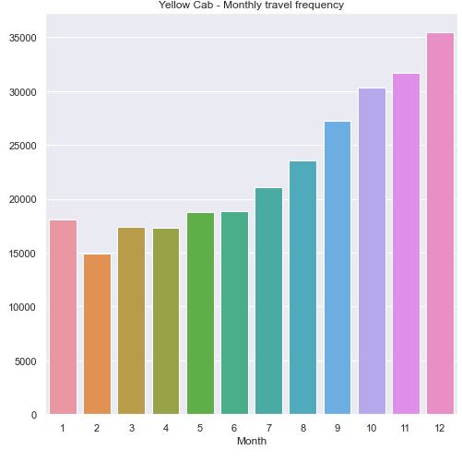
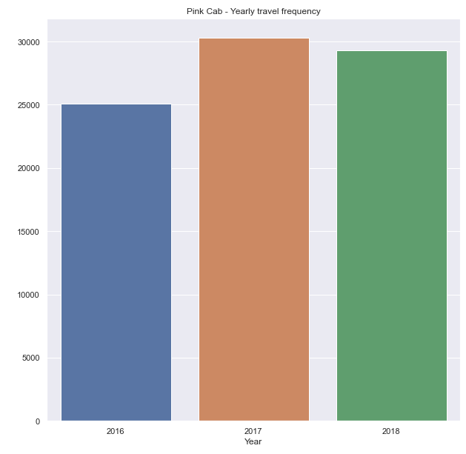
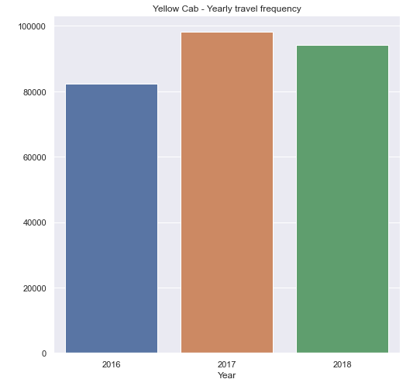
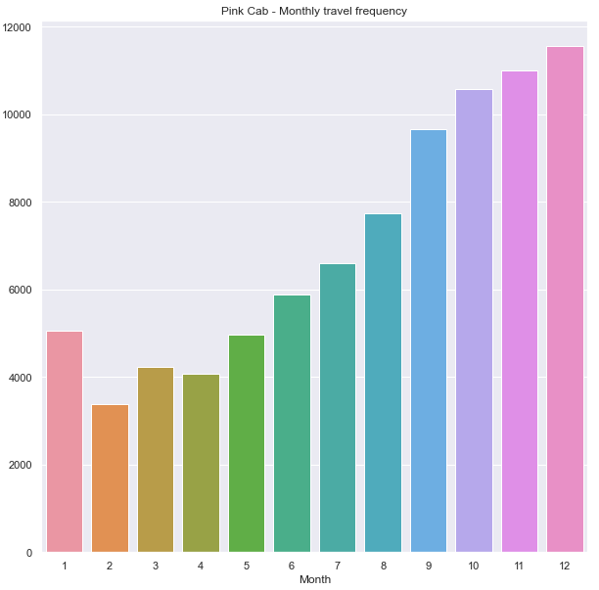
Travel Frequency
From the above graphs we can observe that in December, the travel frequency is very high, due to the holidays season and the fact that is winter and the wheatear is not so good.
The Pink Cab reaches a maximum frequency of almost 12,000 travels, while the Yellow Cab has it’s peak at more than 35,000 travels – both in the month of December.

Slide 5
Both companies had a great year in 2017:
Pink Cab: 30,000 travels
Yellow Cab: almost 100,000
From the travel frequency, Yellow Cab is the winner.

Slide 6
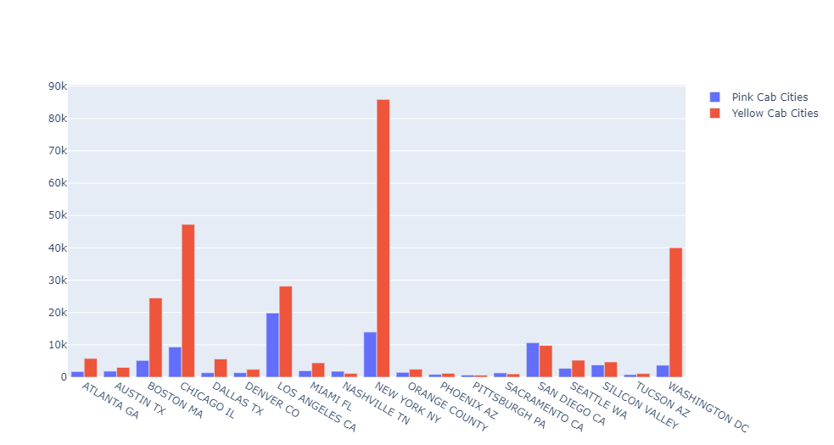
Most “crowded” cities
From the graph, we can observe that the cities with the highest number of travellers are New York, Washington DC, Los Angeles, Chicago and Boston.
Yellow Cab has a superior number of rides in all of the mentioned cities.

Slide 7
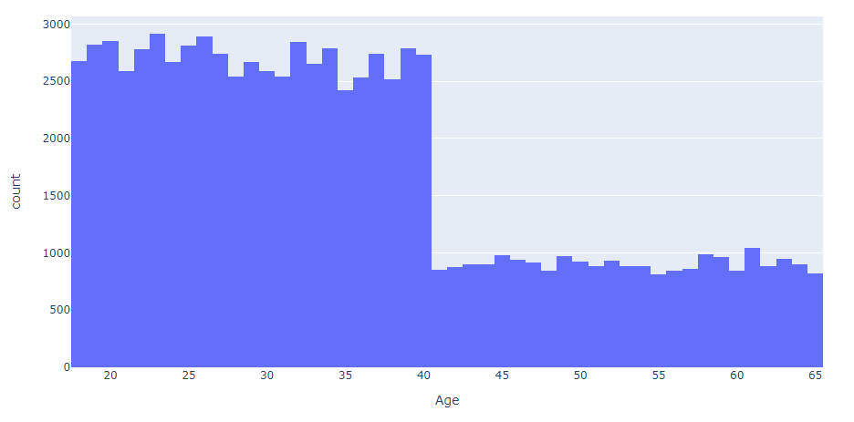
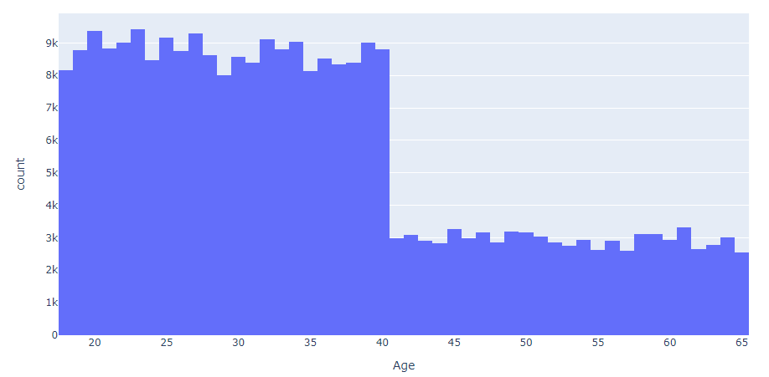
Customers Details
Most of the customers of the two cabs are between 18 – 40 years.
The Yellow Cab has around 234,785 recurring rides from almost 40,000 clients while Pink Cab has 52,381 recurring rides from little more than 32,000 clients.

Slide 8
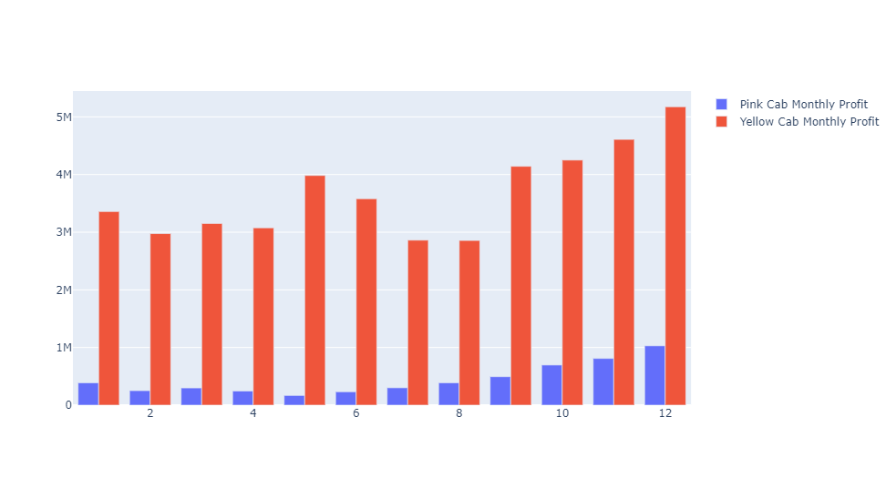
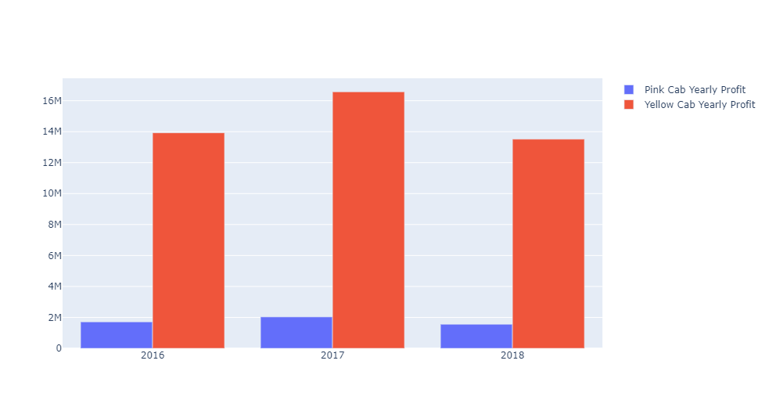

Profit Analysis

Slide 9
The profit of the Yellow Cab totals around 44 mil. $ from 2016 until 2018, compared to the profit of 5,3 mil. $ of the Pink Cab
With respect to total rides, Yellow Cab takes the lead also with more 274,000 rides overall while the Pink Cab has slightly more than 84,500 rides in the analysed period.
Profit per ride is calculated as Total Profit/Total Rides and represents 62.65$ for the Pink Cab. The Yellow Cab has a profit per ride of 160.26$.

Slide 10
Conclusions and recommendations
After a careful analysis of the key factors in taking an investment decision, we found the following:
Yellow Cab has a wider covering range in the main cities of the US.
Customers are around 18 – 40 years old, so most of them could come from corporations, which is a good sign of retention.
Starting from September and up to it’s peak in December, Yellow Cab has a higher travel frequency than the Pink Cab.
The profit margin (and the overall profit) is way much higher for the Yellow Cab than for the Pink Cab.
On the basis of the above mentioned points, we recommend the Yellow Cab for investment.

Slide 11
Thank You

